Slide 1
CISA Secure by Design Software Acquisition Guide (SAG)
Best Practices to Verify Products for Secure by Design and Secure by Default

Slide 2
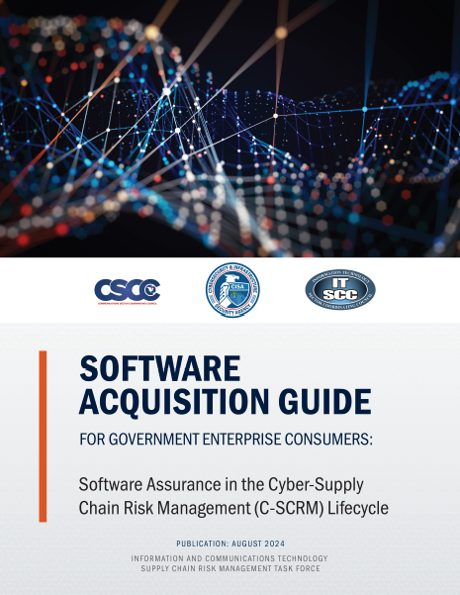
Topics
What is the CISA Software Acquisition Guide (SAG)
Who created the SAG materials
How do Product Manufacturers use the SAG
How do Consumers use the SAG to assess a product for Secure by Design Best Practices
Resources

Slide 3
What is the CISA Software acquisition guide
Aligns with CISA Secure by Design principles but focuses on the “Secure by Demand” elements.
Identifies Secure by Design best practices across the entire software life cycle
Enables acquisition professionals to engage in more relevant discussions with their enterprise risk owners (such as Chief Information Officers and Chief Information Security Officers) and candidate suppliers
A virtual “Secure by Design” checklist for consumers and producers
View the CISA NASPO Webinar
for a comprehensive overview

Slide 4
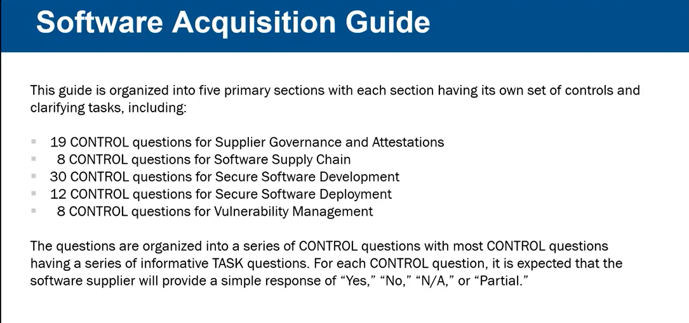

Slide 5

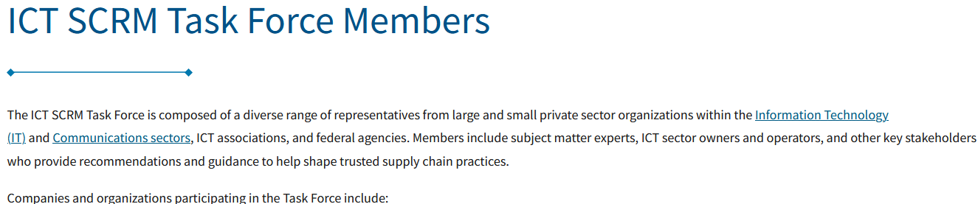
Who created the SAG materials
CISA ICT_SCRM Task Force (CIPAC partnership)
CISA National Risk Management Center
Core group of ~30 people working on the SAG document
Mostly from Government Agencies (NASA, GSA, CISA, NSA) and Private Sector https://www.cisa.gov/ict-scrm-task-force-members
Led and facilitated by CISA personnel over two years
Visionary leadership provided by an expert with decades of experience in software assurance, Joe Jarzombek, https://copilot.microsoft.com/shares/QLhY366t3XSbYmfegpXEa

Slide 6
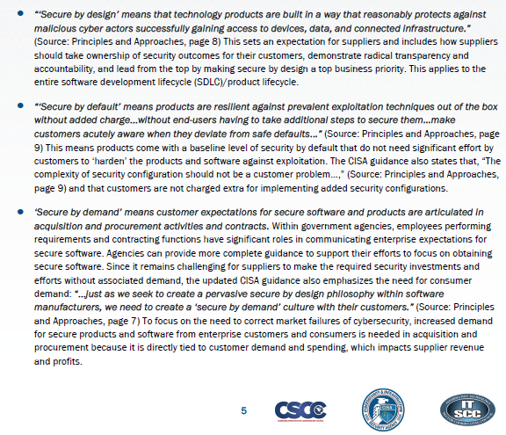
Secure by Design, Default, DEmand

Slide 7
How do Product Manufacturers use the SAG
Self Assessment of adherence to Secure by Design best practices in the SAG
Perform self assessment before submitting a product to the US Government for procurement
Answer the 19 Governance Questions, at a minimum
Address any “red flags” where lack of adherence to Secure by Design could block a product from being purchased
Create SAG Spreadsheet once and send to everyone that asks to show your Secure by Design practices
Track Secure by Design practices per product

Slide 8
How do Consumers use the CISA SAG
Assess a product and supplier for adherence to Secure by Design best practices
Five step process
Download the CISA SAG Spreadsheet
Send the spreadsheet to your suppliers with a cover letter asking them to answer the 19 governance questions, at a minimum and return the completed spreadsheet
Place the completed SAG Spreadsheets received in a permanent location for later review
Evaluate each returned spreadsheet and decide if the provided responses are acceptable within your risk threshold and tolerance
Keep a history of each analysis in a “log book” with PASS/FAIL results

Slide 9
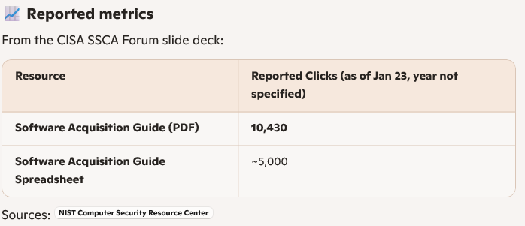
Popularity

Slide 10
Resources
NASA SCRM Process Documentation
https://www.nasa.gov/secure-software-development-self-attestation-resources-and-knowledge/
CISA SAG Videos
NASPO Webinar: https://www.youtube.com/watch?v=_RzQMXE4Df0
Tom Fanning Keynote: https://www.youtube.com/watch?v=0iYITlQfi3A
CISA Free Services and Open Source Tools
https://www.cisa.gov/resources-tools/resources/no-cost-cybersecurity-services-and-tools
https://github.com/rjb4standards/CISASAGReader/blob/main/README.md
CISA SAG Website
https://cisa.gov/sag
SAG Document: https://www.cisa.gov/sites/default/files/2024-07/PDM24050%20Software%20Acquisition%20Guide%20for%20Government%20Enterprise%20ConsumersV2_508c.pdf
SAG Spreadsheet: https://www.cisa.gov/sites/default/files/2024-08/PDM24064%20Software%20Acquisition%20Guide%20for%20Government%20Enterprise%20Consumers%20Final-%2020240710_v19.xlsx
SAG FACT Sheet: https://www.cisa.gov/sites/default/files/2024-10/ICT%20SCRM%20Task%20Force%20Software%20Acquisition%20Guide%20Fact%20Sheet%20%28508%29.pdf
LinkedIn SBOM SIG; Global Community of SBOM Implementers
https://www.linkedin.com/groups/13274064/

Slide 11
Thank you for your time
Dick Brooks
dick@businesscyberguardian.com
https://businesscyberguardian.com/

